Slide 1

Investor Awareness Program
FMS EduTech
Mitez Sheth, Ph.D. | 9833570282
Insta: MitezSheth

Slide 2

Dedicated website for investors by SEBI
FMS EduTech
SEBI has created a website dedicated to investors
Can be accessed at https://investor.sebi.gov.in
Offers valuable insights that can empower the general public to become informed and savvy investor
Features available for benefit of Investors
  Personal Finance & Investment.
  Information about Managing money, Investments and Securities market investments.
  Financial Tools & Calculators .
  Tools and Calculators for various financial matters .
  Check your Financial Health.
  Information about various Investor awareness programs and seminars planned .
  Investor Education and Financial Education Materials.
  Links to important websites relevant for investors.
Investors should visit this website and enhance the knowledge.
BSE - CONFIDENTIAL

Slide 3

Financial Literacy
FMS EduTech
Financial Education
  Helps us in being financially literate
  Develop a positive attitude towards managing income & expenses ; Managing Assets & Liabilities
  Leads us to a situation of financial well being
  Goes beyond savings
  Plan our lives
Notes:
What are we doing really??
20 – 25 years of studies…Phir 20-30 saal kuch karobar karte hai…phir retire ho jate hai…bacche bade ho jate hai..
We have a standard of living….constant or increase…economics is called purchase power parity

Slide 4

Key Concepts
FMS EduTech
What are Savings?
  Savings are the surplus of income over expenditure.
    a. Income- Money earned from various sources like Salary, Wages, Interest, dividends, rent etc.
    b. Expenditure- Money spent on various items which include essential and non-essential items.
People usually meet their short term goals with savings. Money in savings account of a bank earns a small amount of interest and it is easy to withdraw it whenever needed. People can save in savings bank accounts, Post Office savings accounts, etc.
What are Investments?
  Investment is the act of deployment of money out of savings into financial or non-financial products with the expectation of earning higher returns over a period of time.
  The various products in which investments may be done are
    Financial products viz. fixed deposit in bank, buying shares in stock market, investing in Mutual funds, etc. and
    Non-financial products viz. purchase of land, gold, silver, etc.
  The investments may be done for short term, medium term or long-term.
  While investing one should always remember that return on investments may rise or fall over time and it is quite normal for that to happen.
Notes:
Lets have a look at a few core concepts and then proceed to financial literacy and financial planning

Slide 5

Savings VS Investments
FMS EduTech
Sr.No | Savings | Investments
1 | Bank usually or Cash | Financial or Non Financial Products
2 | Balance amount (Income –Exp) | Deployed from Savings (not automatic)
3 | Purpose Maintain Liquidity | Purpose Create Assets Grow Money Generate cash flow Generate Value
4 | Risk Low / Negligible | Risk Depends on asset class
5 | Liquidity High | Liquidity Depends on asset class
6 | Action Required Spend less | Action Required Invest after understanding your requirements
To
Read
At
Home
Notes:
What is the importance of saving and investing?
Investing money makes it grow for you. Any increase in the value of the investment over a period of time, or investment income/returns that you receive, gets you that much closer to your financial goals. One should start saving and investing early in his or her life. The earlier you start, the better you will be placed in meeting your goals like owning a house, financing your child's education, funding for your retirement, etc.

Slide 6
Key Concepts ….
FMS EduTech
What are Assets and Liabilities?
What is Debt?
What is the Time Value of Money?
What is Inflation and its effect on Investments?
How does inflation affect my investment decision?
    A Vada Pav costing 5/- five years ago would now cost 20/-. This increase in the price is not as a result of higher quantity or a better quality of the Vada Pav, but due to inflation impacting the prices of the ingredients and finally the end product.
So the money in your pocket lets say Rs. 5 ; you need to try and make it 20 or more…
What are the steps that you can take to avoid the adverse effects of inflation?
    Try to determine your "real rate of return”, or the return you can expect after factoring in the effects of inflation. To reduce the risk of decrease in the value of money, you can invest the money available to you today at a rate equal or higher than the rate of inflation.
To
Read
At
Home
Notes:
Items that you own and have economic value are your assets and items which you owe to others or have borrowed from others are your liabilities. For example, if you save and then invest in a fixed deposit, it is your asset. On the other hand, if you borrow funds/ take a loan from a bank or any individual, it is your liability.
What is Debt?
Money borrowed to meet shortfall of money when expenses are more than the funds available in hand is called debt.
Time Vaue of Money
At the most basic level, the time value of money shows that time literally is money, i.e. the value of the money you have now is not the same as it will be in the future and vice versa.
What is Inflation and its effect on Investments?
Inflation refers to rise in prices of goods and services. Over a period of time, as the cost of goods and services increases, the ability of a unit of money, say one rupee, to buy goods and services keeps declining. In other words, the Purchasing Power of money, i.e. ability of money to buy anything, decreases. It is important to take into account the effects of inflation on your investments during financial planning. Investors greatly fear inflation since it reduces the value of their investment.

Slide 7
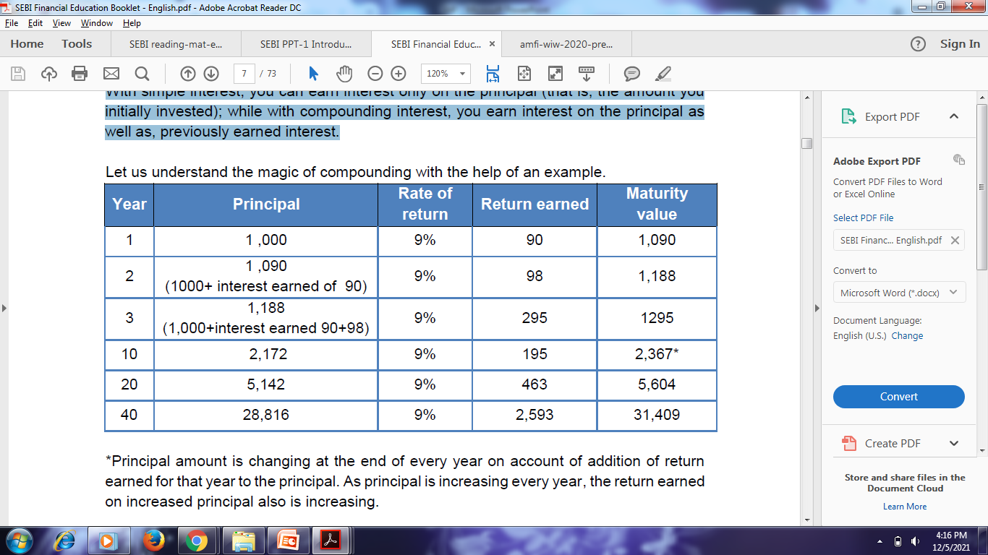
Key Concepts …
FMS EduTech
What is Power of Compounding?
    With simple interest, you can earn interest only on the principal (that is, the amount you initially invested); while with compounding interest, you earn interest on the principal as well as, previously earned interest.
To
Read
At
Home
Notes:
*Principal amount is changing at the end of every year on account of addition of return earned for that year to the principal. As principal is increasing every year, the return earned on increased principal also is increasing.
Whereas in case of simple interest, the principle amount remains at ₹1,000/- only for all the 40 years and with annual interest of ₹90/-, the amount grows to only ₹4,600/-.

Slide 8
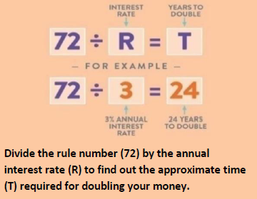
Key Concepts
FMS EduTech
The Rule of 72
  Mathematicians say that you can find out how long it will take you to double your money simply by dividing the number 72 by the interest rate.
  So let's say your parents give you Rs.200/- for your birthday and you plan to invest it. If you put the money into an account that earns 6 percent (6%) interest a year, how long will it take to grow to Rs. 400/-/?
72 / 6% interest = 12 years
So in 12 years, your money will have doubled to Rs. 400/-.
To
Read
At
Home

Slide 9
Key Concepts
FMS EduTech
Impact of 5% Annual Inflation on Expenses over a period of 20 years
To
Read
At
Home

Slide 10
Key Concepts
FMS EduTech
What does Inflation do to your savings?
Impact of 5% Annual Inflation on savings over a period of 20 years
To
Read
At
Home

Slide 11




Inflation; Fiat Currency and Time Value
FMS EduTech
Year 1900 Year 2022
Which do you prefer?
To
Read
At
Home
Notes:
In case of rupee we prefer 100 rupee in 1900 because purchase power of 100 rupee was much higher than 2000 rupee now
But in terms of gold we prefer 100 grams because purchase power of 100 grams is higher than 50 grams.
Fiat Money has created this distortion, which our grand parents did not face. Hence this is a relatively new concept…financial planning and investments.
Unlike gold or slver the paper by itself does not have any value; it has value given by the government; this is fiat currency
Fiat currency gives rise to inflation because the vaue does not increase over time by itself.

Slide 12
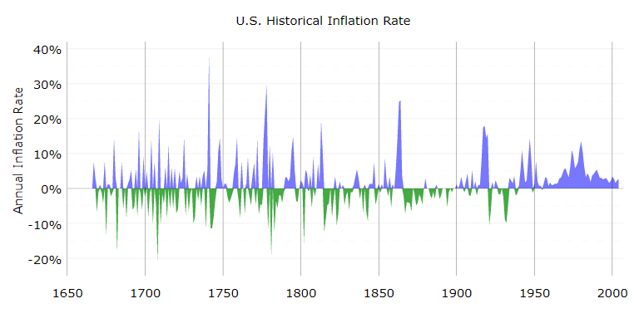
Inflation Not so Long Ago…
FMS EduTech
Sustained All Pervasive
Inflation
Department of Labor Data : https://www.in2013dollars.com/
Notes:
Inflation a pretty recent Phenomenon
A couple of things on this slide
Inflation is a pretty recent Phenomenon; hence our parents and grand parents were happy with Savings and did not require Investments
Inflation was matched by deflation in early years
The currency was limited and hence silver was used as currency; not fait currency; this is why savings were enough and sufficed for non working years. Because ther value grew in time.
Fiat currency value decreases over time.

Slide 13
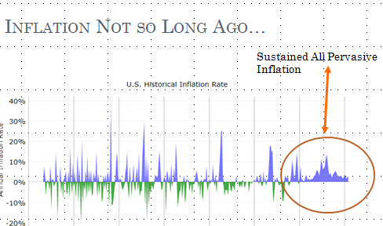
FMS EduTech
The Value of Your Money is decreasing Constantly
Prices are rising constantly

Slide 14
Inflation Good??
FMS EduTech
If you are an
  Investor
  Business Owner
  Keen to grow your Wealth,
      …………….Inflation is essential !!
                Inflation is Good!!
Opposed to Deflation
Notes:
Inflation is ike blood pressure; a constant one is the key…usually 3 to 5 % is good.
Higher sustained all pervasive is bad…lower is even worse.
Some inflation in the economy is good for the economy…shows the economy is growing

Slide 15
Solution ?? Investing Smart
FMS EduTech
Financial Literacy & Financial Planning is key to protection against Inflationary Erosion!!
Start Saving at an early age
Use compounding to your advantage
Progress from Savings to Investments
Put your money to work:
  Let your money make money for you!!

Slide 16
Part 2: Assets? Investments?
FMS EduTech

Slide 17
Economists believe…
FMS EduTech
Land
Metals
Business
Motor Cycle can pass on costs….we cant!!

Slide 18

Part 2
FMS EduTech
Financial Planning Basics

Slide 19

What is Financial Planning ?
FMS EduTech
Financial planning is
  The process of estimating financial needs of a person and
  Implementing a comprehensive plan to meet those financial needs during his or her lifetime through investment.
  For instance, birth of a child, education, purchasing house, marriage, meeting emergency situations like an illness
Notes:
Again this sounds very simple. Ask any of your friends…most people have it all figured out!!! And then ask any adult….most adults do not have it figured out!!!

Slide 20
Financial Planning Process
FMS EduTech
Review
Determine
Review & revise the financial plan
06
01
Determine Current Financial Position
Financial Planning
Create
05
02
Identify
Create & Implement your financial action plan
Identify & Set your financial goals
04
03
Evaluate
Identity
Evaluate Alternatives & Strategies
Identify Suitable Investment Aveues

Slide 21
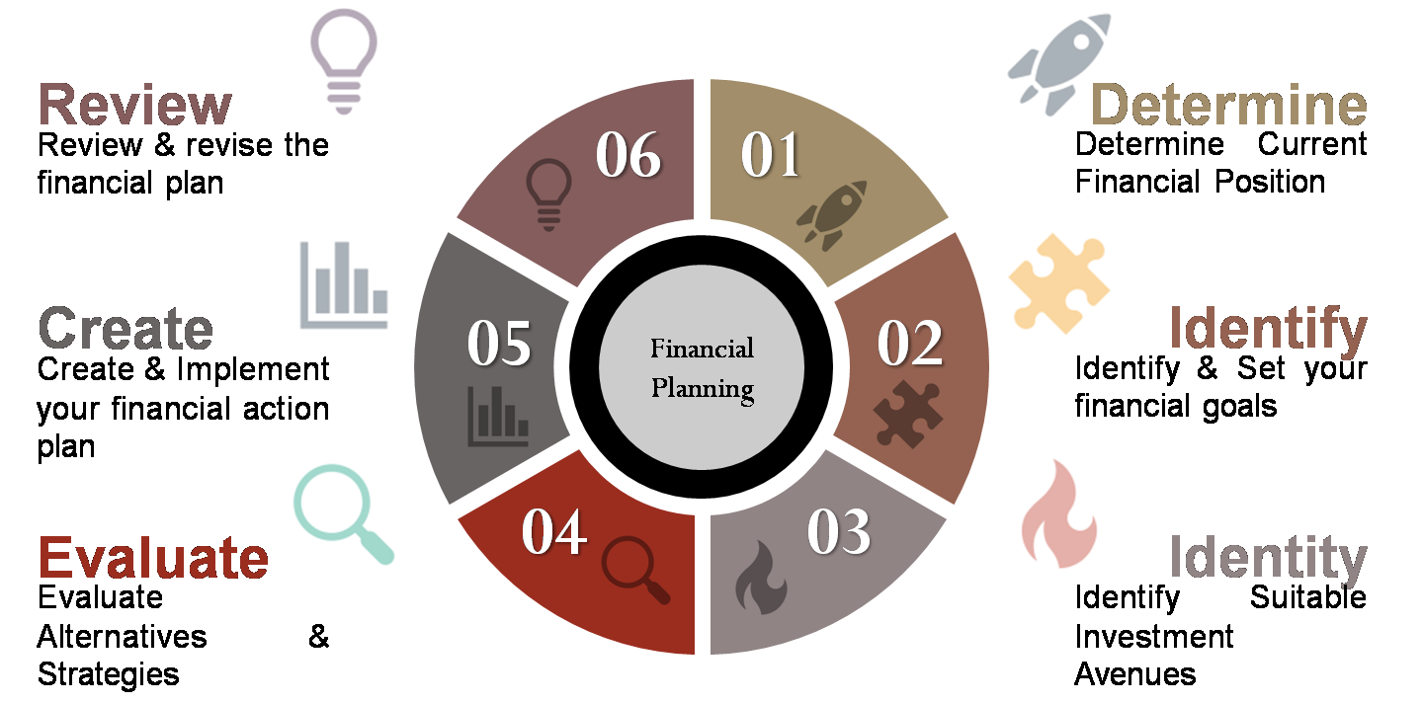
FP Explanations:
FMS EduTech
Determine Current Networth
ASSETS |  | Liabilities
Particulars | Amount | Particulars | Amount
Cash & Bank | 1,00,000/- | Home Loan | 50,00,000/-
Mutual Fund | 5,00,000/- | Credit Card | 50,000/-
House | 65,00,000/-
Total | 71,00,000/- |  | 50,50,000/-
Net Worth | 71 less 50.50 = 20,50,000/-

Slide 22
FP Explanations:
FMS EduTech
Identify & Set Financial Goals
  Acquiring Assets
  Retirement Planning
  Basic Financial Goals (roti kapda makaan)
  Advanced Financial Goals (education, marriage)
Goals may Change over a Period of time
Goals need to be reviewed periodically
Notes:
Individuals can use a variety of investment, risk management and tax planning strategies to meet their financial goals. These goals change over an individual's lifetime and accordingly the financial plan should be reviewed on a regular basis for any modification as per change in the circumstances.

Slide 23
Setting Financial Goals
FMS EduTech
Wealth is not built overnight. One needs to set specific financial goals. A good financial goal should be SMART i.e. Specific, Measurable, Achievable, Realistic and Time-bound.
Notes:
Goal-based investing focuses on meeting goals that are personal and specific. The focus of this approach is to arrive at future value of different goals and then pursuing these goals through asset allocation made for investments according to each individual’s financial goal. To adopt this strategy while investing, one must plan as per one's age, risk appetite (ability to take risk), financial situation and investment horizon.

Slide 24

SMART | Description | Incorrect Approach | Right Approach
Specific | You need to know exactly what you want to achieve and when you want it. | I need to set aside money for my daughter's birthday next year. | I need to set aside Rs. 10,000/- for my daughter's birthday next year.
Measurable | A goal should be measurable so that you know when you will achieve it. | I will pay off most of my credit card dues soon. | In the next six months, I will pay off all my credit card bills in full. Or Rs. 90,000/-
Achievable | Your goal should be within a reasonable reach. | I will save money. | I will save Rs. 4,000/- every month. Or 20% of my salary
Realistic | Your goals need to be based on resources and tasks that you can reasonably achieve. | By saving regularly, I will become a millionaire. | by next December I will be saving the sufficient amount to fund six months of my living expenses. Which is =Rs. 2 lac
Time-bound | Goals with timelines allow you to track your progress and encourage you to keep going until you reach your goal. | I will save money for my sons marriage | I will save Rs. 50,000/- every year for next 10 years for my sons marriage.
FMS EduTech

Slide 25
Five-Step Approach to Achieve Financial Goals
FMS EduTech
STEP 1: Identify specific financial goals
STEP 2: Classify goals into Short-term, Medium term or Long term
STEP 3: Decide upon asset-allocation
STEP 4: Choose the right investments with diversification (within asset classes)
STEP 5: Review and revise financial plans
Lets Study this in details Later

Slide 26
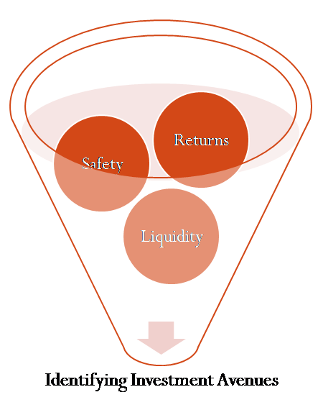
FP Explanations:
FMS EduTech
Asset Allocation
Identify Suitable Investment Avenues
  Safety
  Liquidity
  Returns
Notes:
Three pillars of investment - The investment decision by an individual is influenced by safety, liquidity and return. They are called the three pillars of investment.
i. Safety: This is about how well protected the principal and return on the investment is. For instance, if you lend ₹100/- to someone, will it be repaid on time? Or, is your capital of ₹100/- safe? Safety means your money invested is protected and there is every possibility that on the agreed date, or maybe even before, it would be returned whenever needed.

Slide 27
FP Explanations:
FMS EduTech
Asset Allocation
Asset-Allocation is a strategy for investing your money into various asset classes such as equity and debt that would suit an investor's income and risk appetite.
Asset Classes may be referred to groups of financial instruments which have similar financial characteristics.
Asset Allocation refers to an investment strategy that aims to balance risk and reward - in the form of returns - by dividing the assets of an individual’s portfolio according to his/her financial goals, risk tolerance and investment horizon.

Slide 28
Asset Allocation
FMS EduTech
Allocate assets depending on your age, lifestyle, family commitments and your financial goals.
While allocating your funds, distribute your investments across various asset classes such as equity, bonds, real estate, etc., to benefit from diversification, which helps reduce risk and increases the possibility of earning moderate to high returns on your investments.
Portfolio A
Equity 70%
Other 10%
Portfolio B
Equity 30%
Debt 5%
Portfolio C
Equity 50%
Real Estate 25 %
Debt 20%
Gold 5%
Gold 5%
Real Estate 60 %
Gold 10%
Debt 10%

Slide 29
FP Explanations:
FMS EduTech
Evaluate Alternate Strategies
  Based on requirements, Age, Background,
  Try to maximize returns
  Mitigate Risks
  Delayed Gratification
  Diversification
Notes:
Don't put all eggs (invest all your money) in one basket (asset class).
• Diversification is doing investment in various financial instruments or asset classes.
• Goal is to find an appropriate balance between risk and return.

Slide 30
Make Your Assets Work for you
FMS EduTech
Your Investments should……
Fight Inflation for You
Provide Income
Be Accessible & Usable in parts
Be Realizable at Fair Value & Low Cost
Grow in value & Appreciate over time
Proper Asset Allocation

Slide 31
FP Explanations:
FMS EduTech
Create & Implement
  Based on what we saw earlier
  Discipline
  Understanding financial products
  Not Taking unnecessary risks

Slide 32
FP Explanations:
FMS EduTech
Review & Revise
    Once you invest in any asset class you should monitor your investments on a regular basis and keep yourself updated about various market happenings to take corrective action.
    Always check the potential risks and do proper due diligence when promised returns are usually high.
Notes:
Risk can be defined as the probability or likelihood of a loss occurring in relation to your expected returns from any particular investment. It is a measure of the level of uncertainty of achieving the returns as per investor expectations.
Risk V/S Return
Risk and investing go hand in hand. The good news is that "risk" comes with the potential for "rewards" from investing — which is what makes the whole process worthwhile.

Slide 33
Review ??
FMS EduTech
Investments that Grow in Value
(With Exceptions)
Property
Gold
Art Collection
Equity Shares
Mutual Funds
NSC/ KVP
Bonds
Investments that Generate Income
(with exceptions)
PPF
Bank / Co Deposits
Mutual Funds
The Process of Asset Allocation & Review is a separate session.
But have a look at what assets grow in value and which ones generate income

Slide 34
Risk VS Returns
FMS EduTech
Managing Risks and Maximizing Returns
Risk & Returns relation is a tradeoff
Diversification helps manage Risks
Risks can not be eliminated; but can be mitigated and minimized
No Such Thing as Risk Free Investments

Slide 35
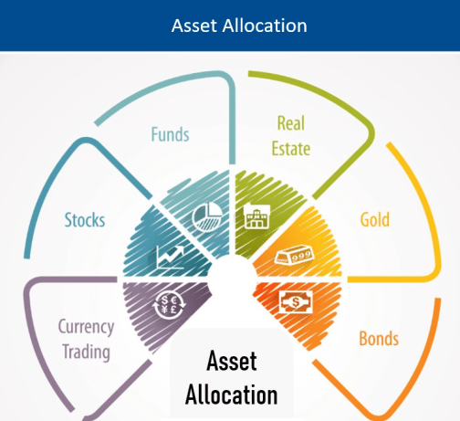
Asset Allocation
FMS EduTech
Part 4

Slide 36
Life Stage Based asset Allocation
FMS EduTech
Early Savers
Pre Retirement
Post Retirement
Mid Life
Equity
Debt
Real Estate
Alternate

Slide 37
Part 5
FMS EduTech
Mutual Funds

Slide 38
What is a Mutual Fund?
FMS EduTech
A mutual fund is the trust that pools the savings of a number of investors
Anybody with an investible surplus of as little as a few hundred rupees can invest in Mutual Funds.
Money collected is invested by a professional fund manager in different types of securities.
Securities could range from shares to debenture, from Government Bond to money market instruments, depending upon the scheme’s stated objective.
Mutual Fund investment gives the market returns and not assured returns.
In the long term market returns have the potential to perform better than other assured return products.
Investment in Mutual Fund is the quite cost efficient as it offers a low charge to the investor

Slide 39
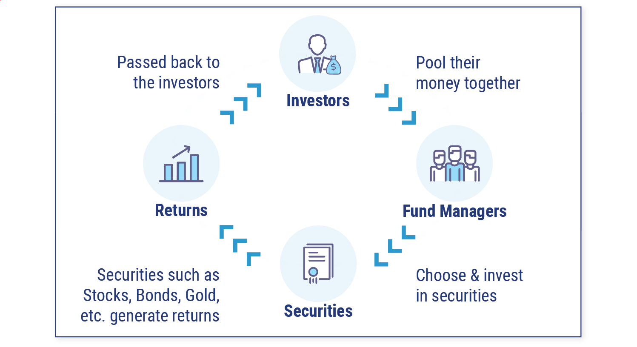
How Does a Mutual Fund Work?
FMS EduTech

Slide 40
Why Mutual Funds ?
FMS EduTech
MF
SEBI Regulated
Professional Management
Low Cost
Transparency
Liquidity
Convenient
Diversification

Slide 41
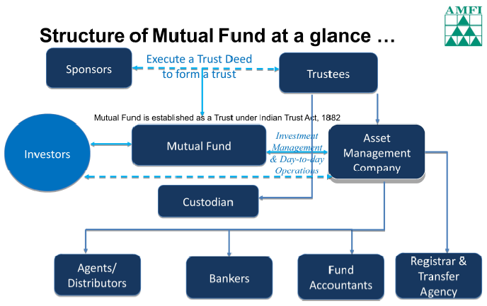
MF Structure
FMS EduTech

Slide 42
Types of Mutual Funds
FMS EduTech
65%
Equity
65%
Debt
Metals
Gold
???
Hybrid

Slide 43
Types of Mutual Funds
FMS EduTech
Organizational Structure
Open Ended or Close Ended Or Interval Fund
Management of Portfolio
Active or Passive
Investment Objective
Growth or Income or Hybrid
Exchange Traded Funds | GOLD ETF or ELSS
Equity or Debt or Hybrid or Liquid
Investment Portfolio
Other Types
Retirement | Pension | Overseas | Fund of Funds

Slide 44
SEBI Categorization
FMS EduTech
As per SEBI guidelines on Categorization and Rationalization of schemes issued in
October 2017, mutual fund schemes are classified as –
    1. Equity Schemes
    2. Debt Schemes
    3. Hybrid Schemes
    4. Solution Oriented Schemes – For Retirement and Children
    5. Other Schemes – Index Funds & ETFs and Fund of Funds
• Under Equity category, Large, Mid and Small cap stocks have now been defined.
• Naming convention of the schemes, especially debt schemes, as per the risk level of underlying portfolio (e.g., Credit Opportunity Fund is now called Credit Risk Fund)
• Balanced / Hybrid funds are further categorised into conservative hybrid fund, balanced hybrid fund and aggressive hybrid fund etc.

Slide 45
Equity Schemes /
Fund Categories
FMS EduTech
Multi Cap Fund* • At least 65% investment in equity & equity related instruments
Large Cap Fund • At least 80% investment in large cap stocks
Large & Mid Cap Fund • At least 35% investment in large cap stocks and 35% in mid cap stocks
Mid Cap Fund • At least 65% investment in mid cap stocks
Small cap Fund • At least 65% investment in small cap stocks

Slide 46
Equity Funds
FMS EduTech
Dividend Yield Fund:
    Predominantly invest in dividend yielding stocks, with at least 65% in stocks
Value Fund
    Value investment strategy, with at least 65% in stocks
Contra Fund
    Scheme follows contrarian investment strategy with at least 65% in stocks
Focused Fund
    Focused on the number of stocks (maximum 30) with at least 65% in equity & equity related instruments
Sectoral/ Thematic Fund
    At least 80% investment in stocks of a particular sector/ theme
ELSS
    At least 80% in stocks in accordance with Equity Linked Saving Scheme, 2005, notified by Ministry of Finance

Slide 47
ELSS Equity Linked Savings Scheme
FMS EduTech
Tax Deduction
Deduction from Taxable Income
Under Section 80C; 1.5 Lacs
Core Invest
Primary investment in Equity
Lock in for Tax purposes
3 years
Shorter compared to other instruments

Slide 48
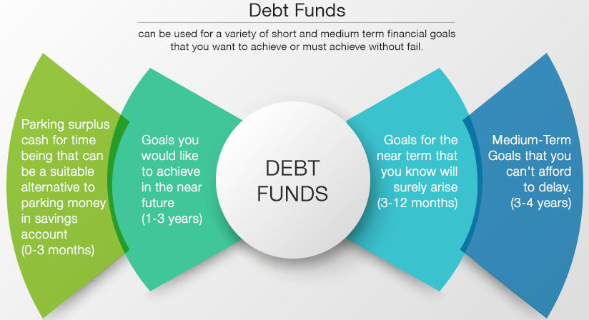
Debt Funds
FMS EduTech
Money Market | Bonds | is primary
Usually referred by corporates and treasuries
Individuals can invest for shorter durations
Not risk free

Slide 49
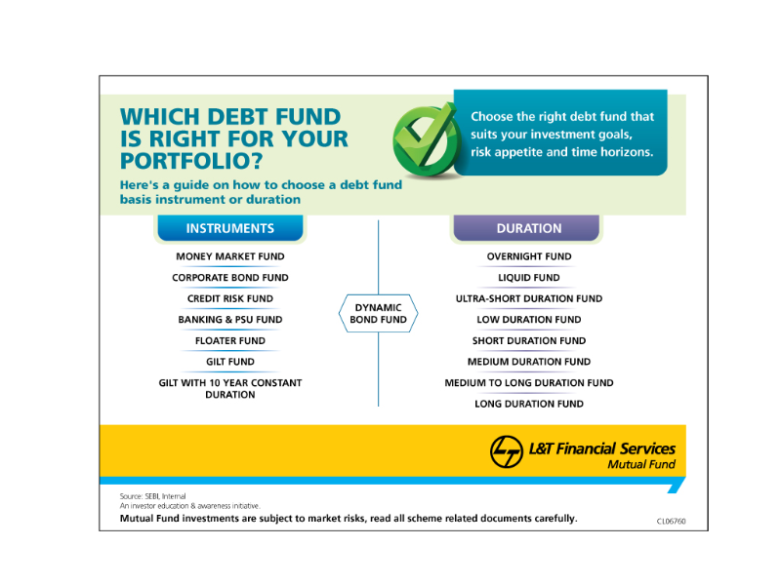
Debt Funds
FMS EduTech

Slide 50
Hybrid Funds
FMS EduTech
A hybrid fund is a classification of a mutual fund or ETF that invests in different types of assets or asset classes to produce a diversified portfolio
Multiple possibilities in mix and match…
SEBI has classified Hybrid funds in to 7 sub categories
Sr. No | Types | What is means?
1 | Conservative Hybrid Fund | 10% to 25% investment in equity & Equity related instruments and 75% to 90% in debt instruments
2 | Balanced Hybrid | 40 % to 60% in Equity and 40% to 60% in Debt
3 | Aggressive | 65% to 80 % in Equity & 20 % to 35% in debt
4 | Dynamic / Balance | 0 to 100 % in Equity & 0 to 100% in Debt
5 | Multiasset | Investment in 3 asset classes with 10 % minimum in each
6 | Arbitrage | Core stratgy is Arbitrage with minimum 65% in Equity
7 | Equity Savings | Equity minimum 65% & Debt min 10% & Derivatives

Slide 51
Solution Oriented
FMS EduTech
Sr. No | Particulars | Details
1 | Retirement | Lock in atleast 5 years or till retirement which ever is earlier
2 | Children | Lock-in for at least 5 years or till the child attains age of majority whichever is earlier
3 | Index / ETF’s | Minimum 95% investment in securities of a particular index
4 | Fund of Funds (Overseas/ Domestic) | Minimum 95% investment in the underlying funds

Slide 52
Index Fund
FMS EduTech
An index mutual fund is an investment product that aims to match, rather than exceed, the performance of an underlying index.
  Examples of the kinds of indexes tracked by index funds include the BSE Sensex, Standard & Poor's 500 Index, better known as the S&P 500, or the Dow Jones Industrial Average (DJIA).
  Index funds have grown in popularity in recent years, as a growing number of investors have adopted passive investing strategies.
  One of their main strengths is the low fees that they charge relative to active investment funds.
Index funds create a portfolio that mirrors a market index
  The securities included in the portfolio and their weights are the same as that in the index
  The fund manager does not rebalance the portfolio based on their view of the market or sector
  The fund offers the same return and risk represented by the index it tracks
  The fees that an index fund can charge is capped at 1.5%
  Investors have the comfort of knowing the stocks that will form part of the portfolio, since the composition of the index is known

Slide 53
ETF Exchange Traded Fund
FMS EduTech
An ETF is a marketable security that tracks an index, a commodity, bonds, or a basket of assets like an index fund.
Unlike regular mutual funds, an ETF trades like a common stock on a stock exchange. The traded price of an ETF changes throughout the day like any other stock, as it is bought and sold on the stock exchange.
ETFs are passively managed, which means that the fund manager makes only minor, periodic adjustments to keep the fund in line with its index.
Rather than investing in an ‘active’ fund managed by a fund manager, when you buy units of an ETF you're harnessing the power of the market itself.
Because an ETF tracks an index without trying to outperform it, it incurs lower administrative costs than actively managed portfolios.

Slide 54
Gold ETF
FMS EduTech
Gold ETF is a open ended scheme which invest pure physical gold bullion of 99.5 per cent purity. The scheme may also invest gold related instruments approved by SEBI and Gold Deposit Scheme of banks up to 20% of net assets
  Gold ETFs issue units against gold held in the portfolio. Each unit represents a defined weight in gold, typically one gram.
  The price of Gold ETF unit moves in line with the domestic price of gold.
  Gold ETF are benchmarked against the price of gold.
  Gold ETFs are considered as non-equity mutual funds for the purpose of taxation
Eligible for long-term capital gains benefits if held for 3 years
  No wealth tax is applicable on Units of Gold ETFs

Slide 55
International Funds
FMS EduTech
International funds enable investments in markets outside India, by holding in their portfolio one or more of the following:
    – Equity of companies listed abroad.
    – ADRs and GDRs of Indian companies.
    – Debt of companies listed abroad.
    – ETFs of other countries.
    – Units of passive index funds in other countries.
    – Units of actively managed mutual funds in other countries.
International equity funds may also hold some of their portfolios in Indian equity or debt.
They can hold some portion of the portfolio in money market instruments to manage liquidity.

Slide 56
Fund of Funds
FMS EduTech
Fund of funds are mutual fund schemes that invest in the units of other schemes of the same mutual fund or other mutual funds
    (Hence FoF is also known as multi-manager fund).
    Its portfolio contains Units of different underlying mutual fund scheme in which the FoF has invested.
The FoF will have two levels of expenses –
    a) that of the scheme whose units the FoF invests in and
    b) the expense of the FoF itself
SEBI Mutual Funds Regulations have capped the total expenses that can be charged across both levels
FoF provide benefit of risk diversification and portfolio diversification with small amounts of investment.

Slide 57
Arbitrage Funds
FMS EduTech
“Arbitrage” is the simultaneous purchase and sale of an asset to take advantage of the price differential in the two markets and profit from price difference of the asset on different markets or in different forms.
Arbitrage fund buys a stock in the cash market and simultaneously sells it in the Futures market at a higher price to generate returns from the difference in the price of the security in the two markets.
  The fund takes equal but opposite positions in both the markets, thereby locking in the difference.
    The positions have to be held until expiry of the derivative cycle and both positions need to be closed at the same price to realize the difference.
    The cash market price converges with the futures market price at the end of the contract period. Thus it delivers risk-free profit for the investor/trader.(in theory)
Price movements do not affect initial price differential because the profit in one market is set-off by the loss in the other market.
Hence, Arbitrage funds are a good choice for cautious investors who want to benefit from a volatile market without taking on too much risk.

Slide 58
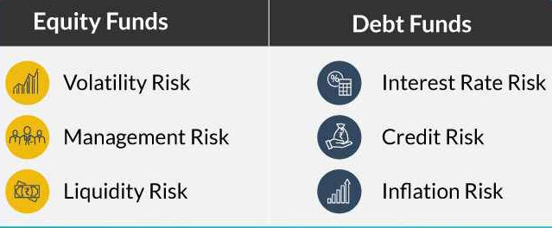
Mutual Funds Risk Returns
FMS EduTech
Risk | Returns | Type
Higher Risk | Higher Returns | Equity Schemes
Moderate Risk | Moderate Returns | Hybrid Schemes
Low – Moderate Risk | Low – Moderate Returns | Debt Schemes
Very Low Risk | Lower Returns | Liquid Schemes

Slide 59
Scheme Related Documents
FMS EduTech
Part 5

Slide 60
Important Documents
FMS EduTech
Scheme information document (SID)
    – SID contains information that is specific to a each MF scheme.
    – Concise & detailed information that a prospective investor should know so as to take an informed decision to invest
Statement of Additional Information(SAI)
    – SAI contains information with regards to each mutual fund and is common across all schemes of a mutual fund.
Key Information Memorandum (KIM)
    – Abridged version of SID
    – Simple to understand and contains key / essential information that investors need to be aware about before they invest
“One must read & understand scheme related documents before investing in a mutual fund scheme.”

Slide 61
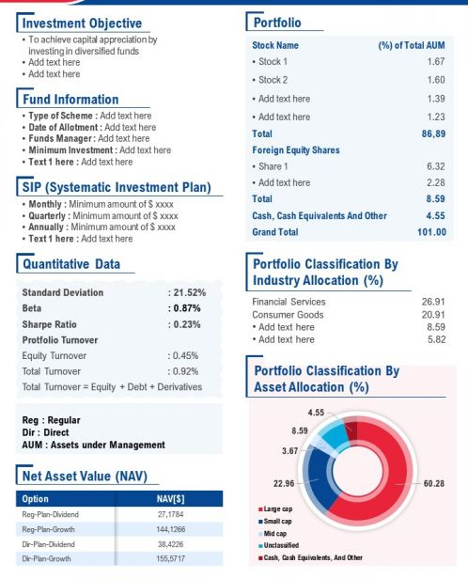
Fact Sheet
FMS EduTech
Fact sheets help you assess a scheme and keep track of its performance
Issued every month
Easy to understand and provides a snapshot of the scheme
Show following key information at a
glance:
  – NAV
  – Returns
  – Fund Managers managing the portfolio
  Risk-o-meter
  Other statistics allowing investors to compare mutual funds and decide which ones to invest in.

Slide 62
Pre Requisites for Investing
FMS EduTech
Pre-requisites
    1. KYC (Know Your Customer) Process
    2. PAN Card
    3. Bank Account
Steps to complete KYC Process
    Visit any MF Branch Investor Service Centre / Branch with required KYC
    Documents, namely –
    i. Address Proof Aadhaar Card, Passport, Tel. bill etc.
    ii. Identity Proof PAN Card, Aadhaar Card, Passport, Voter’s card etc.
    Submit Completed KYC form with photograph with required documents
After completing KYC, you can open a MF Folio with any Mutual Fund and start investing .

Slide 63
How to Invest in a MF?
FMS EduTech
One can invest in a Mutual Fund scheme Offline or Online
• Offline (physical application) mode
    – Duly completed scheme application form signed by all applicants
    – Cheque or bank draft for the amount to be invested
    – Submit the above at the branch office or designated Investor Service Centres (ISC) of mutual funds or Registrar & Transfer Agents & MFU
• Online mode
    – Websites of the respective Mutual Funds
    – Websites of Mutual Fund Distributors
    – Buy mutual funds units through Stock Exchange platforms just like a company stock
    – MF Utilities (MFU) a technology based shared service platform for MF transactions promoted by the mutual fund industry for participating mutual funds.

Slide 64
SEBI Complaints Redress
System
FMS EduTech
SEBI has provided a centralized web based complaints redress system on its portal, named 'SCORES’.
If you are not satisfied with the response from a particular Mutual Fund/company/intermediary, you may then lodge an online complaint with SEBI through SCORES to get your complaint redressed.
SEBI takes up the complaints registered via SCORES with the concerned company / mutual fund / intermediary for timely redressal.
To log on to SCORES System, please visit http://scores.gov.in/

Slide 65

Thank You
FMS EduTech

